Slide 1
Retrieving Data Using HTTP

Slide 2



Web Browser
Web Server
index.html
index.html
JavaScript
JavaScript
http://mysite/api/products/5
Web
Service
Response
Da_{D}t_{B}a

Slide 3

Module Overview
Observables and Reactive Extensions
Sending an HTTP request Exception handling Subscribing to an Observable

Slide 4
Application Architecture
Welcome Component
index.html
App Component
Product List Component
Star Component
Product Detail Component
Product Data Service

Slide 5
To understand the HTTP code, it's important to understand Reactive Extensions and Observables

Slide 6

Reactive Extensions (RxJS)
A library for composing data using observable sequences
And transforming that data using operators
Similar to .NET LINQ operators
Angular uses Reactive Extensions for working with data
Especially asynchronous data

Slide 7


Synchronous vs. Asynchronous
Synchronous: real time
Asynchronous: No immediate response
HTTP requests are asynchronous: request and response

Slide 8
Getting Data
Application
Get me products
Web Server
Get me a list of products
Notify me when the response arrives
I'll continue along
At some later point in time…
Application
Here are the products
Web Server
"Hey, your data arrived"
OK, I'll process it. Thanks!

Slide 9
Observable
A collection of items over time
Unlike an array, it doesn't retain items
Emitted items can be observed over time
Array: [ A, P, P, L, E ]
Observable:
A P P L E

Slide 10




What Does an Observable Do?
Nothing until we subscribe
next: Next item is emitted
error: An error occurred and no more items are emitted
complete: No more items are emitted

Slide 11
Getting Data
Application
Get me products
Web Server
Call http get
http get returns an Observable, which will emit notifications
Subscribe to start the Observable and
the get request is sent
Code continues along
At some later point in time…
Application
Here are the products
[{cart},{hammer},{saw}]
Web Server
The response is returned
The Observable emits a next
notification
We process the emitted response

Slide 12
Observable Pipe
Lowercase operator
Enlarge operator
a
A
a

Slide 13
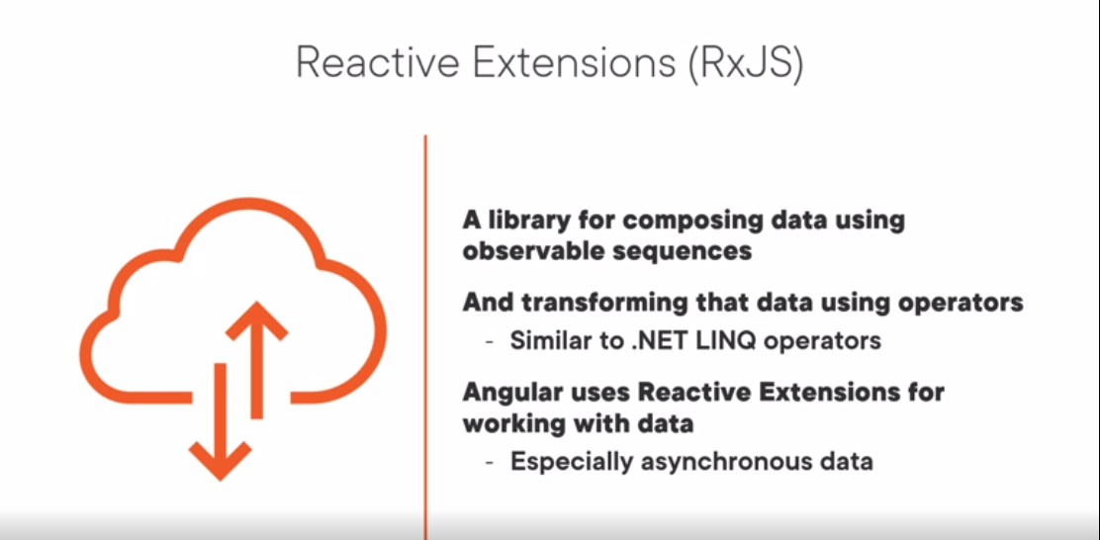

Slide 14




Common Observable Usage
Start the Observable (subscribe)
Pipe emitted items through a set of operators
Process notifications: next, error, complete
Stop the Observable (unsubscribe)

Slide 15
Example
Example
Result
import { Observable, range } from 'rxjs'; import { map, filter } from 'rxjs/operators';
0
6
12
18
24
const source$: Observable<number> = range(0, 10);
source$.pipe( map(x => x * 3),
filter(x => x % 2 === 0)
).subscribe(x => console.log(x));

Slide 16
Application Architecture
Welcome Component
index.html
App Component
Product List Component
Star Component
Product Detail Component
Product Data Service

Slide 17

Sending an HTTP Request
Product Data Service
Http Client Service
Get
GET
Web Server
Response
Response

Slide 18
Setting up an HTTP Request
product.service.ts
...
import { HttpClient } from '@angular/common/http';
@Injectable({ providedIn: 'root'
})
export class ProductService {
private productUrl = 'www.myWebService.com/api/products';
constructor(private http: HttpClient) { } getProducts() {
return this.http.get(this.productUrl);
}
}

Slide 19
Registering the HTTP Service Provider
app.module.ts
...
import { HttpClientModule } from '@angular/common/http';
@NgModule({ imports: [
BrowserModule, FormsModule, HttpClientModule ],
declarations: [
AppComponent, ProductListComponent, ConvertToSpacesPipe, StarComponent ],
bootstrap: [ AppComponent ]
})
export class AppModule { }

Slide 20
AppModule
BrowserModule |  | FormsModule |  | HttpClientModule
AppComponent
ProductList - Component
ConvertToSpaces - Pipe
StarComponent
Imports Exports Declarations Bootstrap

Slide 21
Setting up an HTTP Request
product.service.ts
...
import { HttpClient } from '@angular/common/http';
@Injectable({ providedIn: 'root'
})
export class ProductService {
private productUrl = 'www.myWebService.com/api/products';
constructor(private http: HttpClient) { } getProducts() {
return this.http.get(this.productUrl);
}
}

Slide 22
Setting up an HTTP Request
product.service.ts
...
import { HttpClient } from '@angular/common/http';
@Injectable({ providedIn: 'root'
})
export class ProductService {
private productUrl = 'www.myWebService.com/api/products';
constructor(private http: HttpClient) { } getProducts() {
return this.http.get<IProduct[]>(this.productUrl);
}
}

Slide 23
Setting up an HTTP Request
product.service.ts
...
import { HttpClient } from '@angular/common/http'; import { Observable } from 'rxjs';
@Injectable({ providedIn: 'root'
})
export class ProductService {
private productUrl = 'www.myWebService.com/api/products';
constructor(private http: HttpClient) { } getProducts(): Observable<IProduct[]> {
return this.http.get<IProduct[]>(this.productUrl);
}
}

Slide 24
Demo
Setting up an HTTP request
Note: Angular Http deprecated
Reference: https://pixel-tones.com/angular-http-deprecated/

Slide 25
Exception Handling
product.service.ts
...
import { HttpClient, HttpErrorResponse } from '@angular/common/http'; import { Observable } from 'rxjs';
import { catchError, tap } from 'rxjs/operators';
...
getProducts(): Observable<IProduct[]> {
return this.http.get<IProduct[]>(this.productUrl).pipe( tap(data => console.log('All: ', JSON.stringify(data))), catchError(this.handleError)
);
}
private handleError(err: HttpErrorResponse) {
}

Slide 26

Subscribing to an Observable
x.subscribe()
x.subscribe(Observer) x.subscribe({
nextFn,
errorFn, completeFn
})
const sub = x.subscribe({ nextFn,
errorFn, completeFn
})

Slide 27
Subscribing to an Observable
product.service.ts
getProducts(): Observable<IProduct[]> {
return this.http.get<IProduct[]>(this.productUrl).pipe( tap(data => console.log('All: ', JSON.stringify(data))),
catchError(this.handleError)
);
}
product-list.component.ts
ngOnInit(): void { this.productService.getProducts().subscribe({
next: products => this.products = products,
error: err => this.errorMessage = err
});
}

Slide 28



Unsubscribing from an Observable
Store the subscription in a variable
Implement the OnDestroy lifecycle hook
Use the subscription variable to unsubscribe

Slide 29
Unsubscribing from an Observable
product-list.component.ts
ngOnInit(): void {
this.sub = this.productService.getProducts().subscribe({ next: products => this.products = products,
error: err => this.errorMessage = err
});
}
ngOnDestroy(): void { this.sub.unsubscribe();
}

Slide 30
Demo
Subscribing to an Observable
Unsubscribing from an Observable

Slide 31
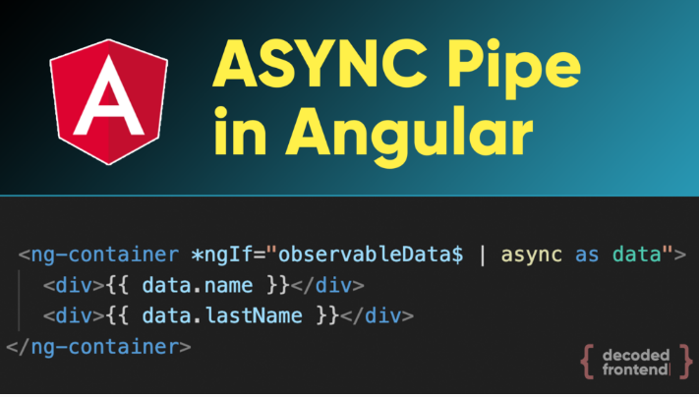
Use Observable Subscriptions & Async-Pipe to Prevent Memory Leaks

Slide 32
Demo
Use Async-Pipe to Prevent Memory Leaks
#1 TO CREATE -> IMPLEMENT ‘Observable’
#2 TO DISPLAY -> RESOLVE ‘Observable’

Slide 33
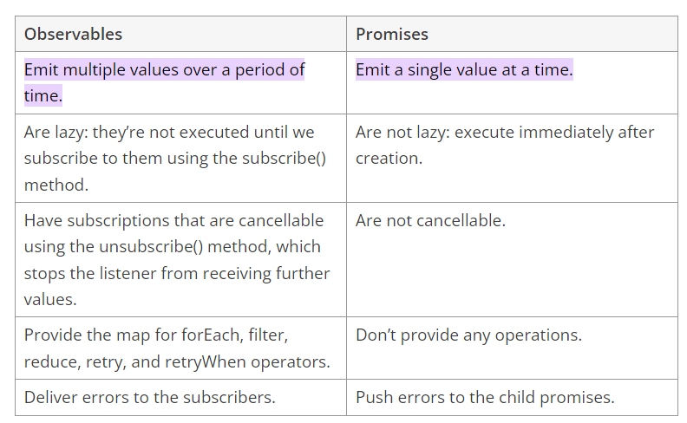
Angular Promises Versus Observables

Slide 34
Code snippets / examples of a few operations defined by observables and promises

Slide 35
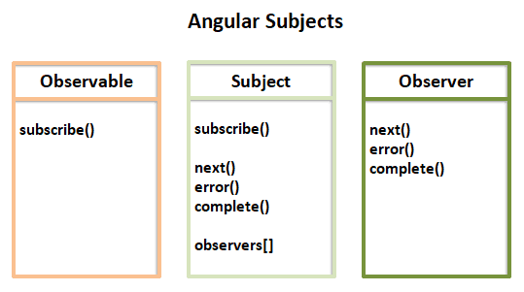

Slide 36
Demo
Subjects in Angular

Slide 37

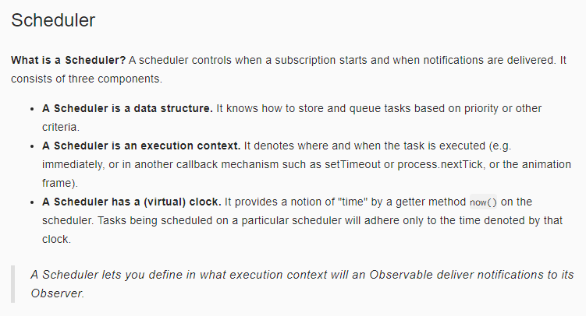
Scheduler

Slide 38
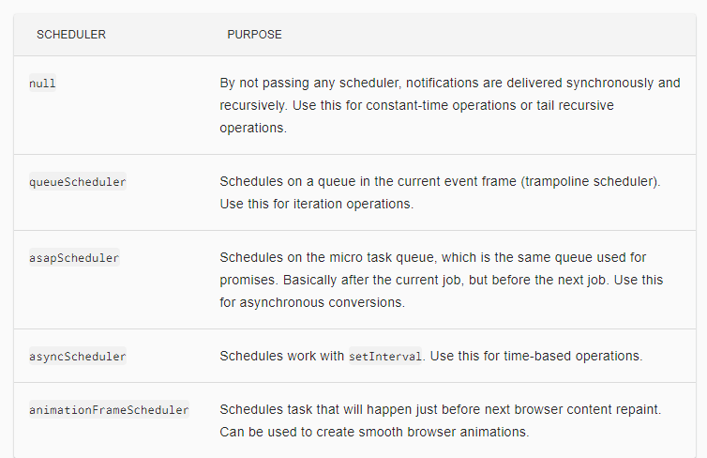
Scheduler Types

Slide 39
Demo
RxJs Scheduler

Slide 40
Demo
Requesting non-JSON data

Slide 41
Demo
Send Data via HTTP using Angular HttpParams
Reference: https://angular.io/guide/http-server-communication,
https://angular.io/guide/http-request-data-from-server

Slide 42
Demo
Handle HTTP errors using Interceptors

Slide 43
Benefits of HttpInterceptors
Code reusability
Scalability
Better service layer

Slide 44
RxJs 6 Support
Reference: https://angular.io/guide/rx-library

Slide 45
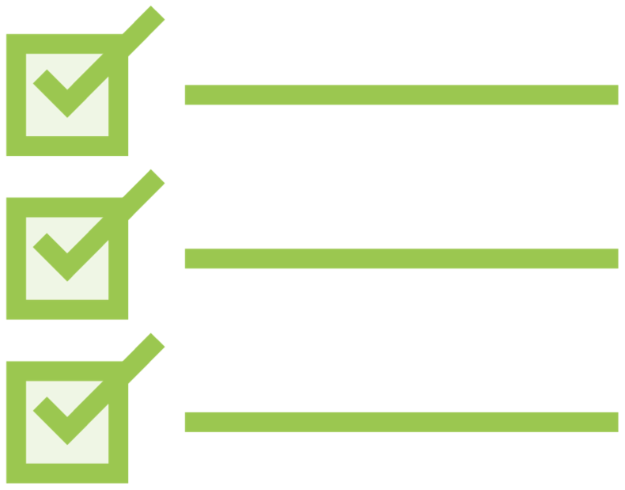
HTTP
Checklist:
Setup
Add HttpClientModule to the imports array of one of the application's Angular Modules
@NgModule({ imports: [
BrowserModule, FormsModule,
HttpClientModule ],
declarations: [...], bootstrap: [ AppComponent ]
})
export class AppModule { }

Slide 46
HTTP
Checklist:
Calling HTTP Get
Define a dependency for the Http Client Service in the constructor
Create a method for each HTTP request Call the desired HTTP method, such as get
Use generics to specify the returned type
export class ProductService {
private productUrl = 'www.myService.com/api/products';
constructor(private http: HttpClient) { } getProducts(): Observable<IProduct[]> {
return this.http.get<IProduct[]>(this.productUrl);
}
}

Slide 47
HTTP
Checklist:
Exception Handling
Add error handling
getProducts(): Observable<IProduct[]> {
return this.http.get<IProduct[]>(this.productUrl).pipe(
tap(data => console.log(JSON.stringify(data))), catchError(this.handleError)
);
}
private handleError(err: HttpErrorResponse) {
}

Slide 48
HTTP
Checklist:
Subscribing
Call the subscribe method of the returned observable Provide a function to handle an emitted item
Provide a function to handle any returned errors
ngOnInit(): void { this.productService.getProducts().subscribe({
next: products => this.products = products, error: err => this.errorMessage = err
});
}

Slide 49
HTTP
Checklist:
Unsubscribing
Store the subscription in a variable
this.sub = this.ps.getProducts().subscribe(…)
Implement the OnDestroy lifecycle hook
export class PLComponent implements OnInit, OnDestroy
Use the subscription variable to unsubscribe
ngOnDestroy(): void { this.sub.unsubscribe();
}

Slide 50
Application Architecture
Welcome Component
index.html
App Component
Product List Component
Star Component
Product Detail Component
Product Data Service

Slide 51

Coming up next …
Navigation and Routing Basics

